Slide 1


ChatGPT Sentiment Analysis
Distributed & Scalable Data Engineering

Slide 2



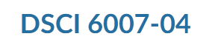
TEAM XIII
SHREYA BANIK
BHIRAVAJOSYULA KRISHNA SAI
TEAM LEAD
TEAM MEMBER

Slide 3

BUSINESS QUESTIONS​
PROBLEM
What is the overall sentiment trend of customer reviews for ChatGPT over the past year, and how does it compare to the previous year?
1
PROBLEM
Which specific features or aspects of the product are driving positive or negative sentiment among customers?
2
PROBLEM
Are there any geographical or demographic patterns in customer sentiment towards the product?
3

Slide 4
BUSINESS PROPOSALS
SOLUTION
By leveraging data engineering, we can efficiently process and analyze large volumes of customer review data, enabling us to identify trends and patterns in sentiment over time.
1
SOLUTION
Data engineering allows us to extract and analyze sentiment from unstructured text data, enabling us to pinpoint specific product features or aspects driving positive or negative sentiment among customers.
2
SOLUTION
we can integrate demographic and geographic data with sentiment analysis results, enabling us to uncover nuanced insights into regional or demographic variations in customer sentiment
3

Slide 5















CRISP - DM - METHODOLOGY
DATA UNDERSTANDING
MODELLING
Build a model and train the parameters
Gather the required data for analysis
BUSINESS UNDERSTANDING
DATA PREPARATION
EVALUATION & DEPLOYMENT
Identify the problem and form a thesis statement.
Data cleaning and structure the data with types
Deploy & valuate the mofdel results

Slide 6
BUSINESS UNDERSTANDNG
01
Customer Insights: Gain valuable insights into customer sentiments across various channels.
02
Decision Support: Utilize sentiment analysis for data-driven decision-making to enhance products and services.
03
Competitive Edge: Identify areas for improvement and opportunities for differentiation.
04
Reputation Management: Proactively manage brand reputation by addressing feedback.
05
Strategic Planning: Use sentiment insights to inform marketing and product strategies.

Slide 7

DATA UNDERSTANDING
Stage 1
Data Sources: Gather data from customer reviews, social media, surveys, etc.
Stage 4
02
Data Cleaning: Remove inconsistencies and standardize text for analysis.
Stage 2
03
Data Scope: Understand the types of data available and their relevance to the project.
Stage 5
01
Quality Assessment: Evaluate data quality and reliability before analysis.
Stage 3
04
Data Privacy: Ensure compliance with privacy regulations when handling sensitive information.
05

Slide 8
01
02
03
DATA SCOPE: UNDERSTAND THE TYPES OF DATA AVAILABLE AND THEIR RELEVANCE TO THE PROJECT.
DATA SOURCES: GATHER DATA FROM CUSTOMER REVIEWS, SOCIAL MEDIA, SURVEYS, ETC.
DATA CLEANING: REMOVE INCONSISTENCIES AND STANDARDIZE TEXT FOR ANALYSIS.
04
05
QUALITY ASSESSMENT: EVALUATE DATA QUALITY AND RELIABILITY BEFORE ANALYSIS.
DATA PRIVACY: ENSURE COMPLIANCE WITH PRIVACY REGULATIONS WHEN HANDLING SENSITIVE INFORMATION.
DATA PREPARATION

Slide 9
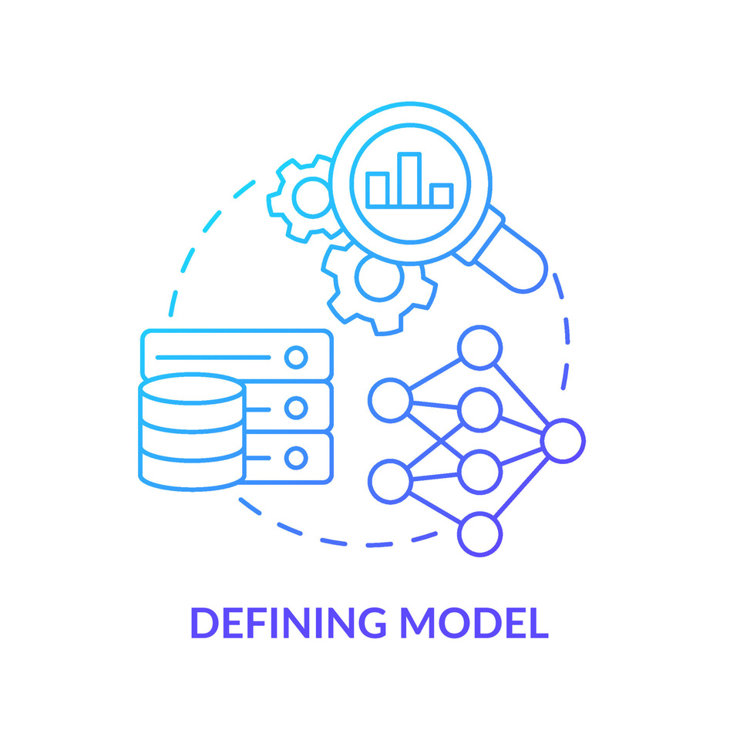
MODELLING
Model Selection: Choose appropriate models like ChatGPT for sentiment analysis.
Training: Train the selected model using labeled data to recognize sentiment patterns.
Evaluation: Assess model performance using metrics like accuracy, precision, and recall.
Fine-Tuning: Adjust model parameters to improve performance on specific tasks or datasets.
Validation: Validate model results against ground truth or real-world feedback.

Slide 10

EVALUATION
1
Metric Selection: Choose relevant metrics such as accuracy, precision, and recall.
4
Benchmarking: Compare model performance against baseline or industry standards.
2
Cross-Validation: Validate model robustness using techniques like k-fold cross-validation.
5
Interpretation: Interpret evaluation results to understand model strengths and weaknesses.
3
Feedback Loop: Use evaluation insights to refine models and improve future iterations.

Slide 11
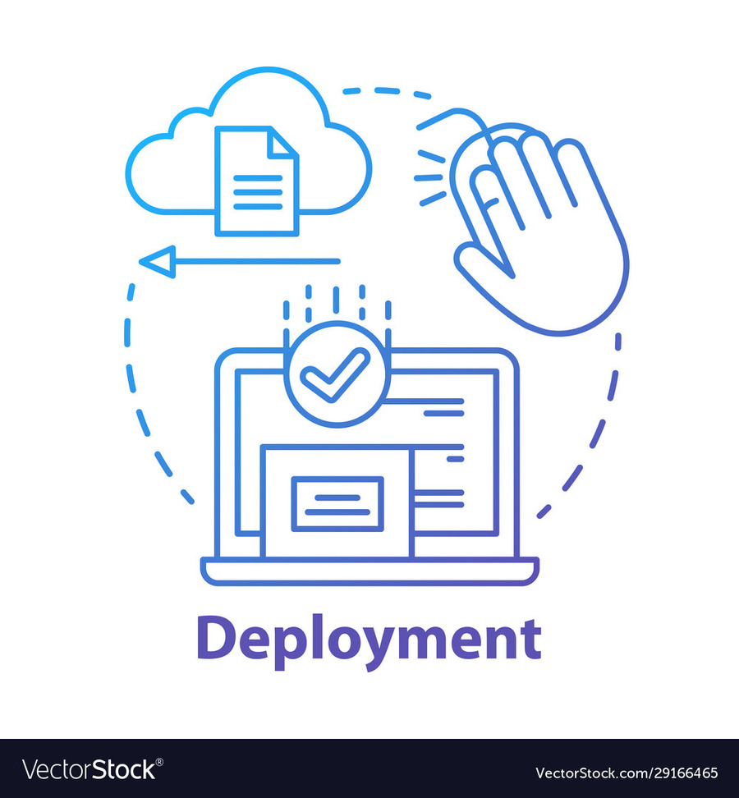
INTEGRATION
Integrate the sentiment analysis model into existing systems or workflows.
API DEVELOPMENT
Develop APIs using frameworks like Flask for model access.
SCALABILITY
Ensure the deployment infrastructure can handle varying workloads and data volumes.
MONITORING
Implement monitoring tools to track model performance and detect anomalies.
MAINTENANCE
Regularly update and maintain the deployed model to ensure optimal performance over time.

Slide 12
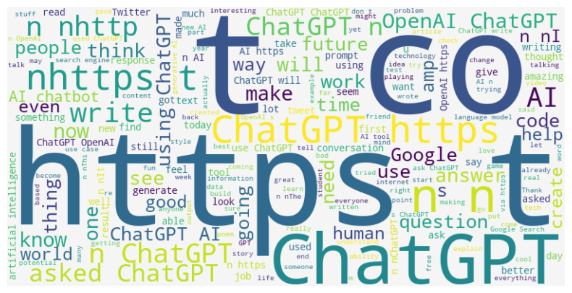
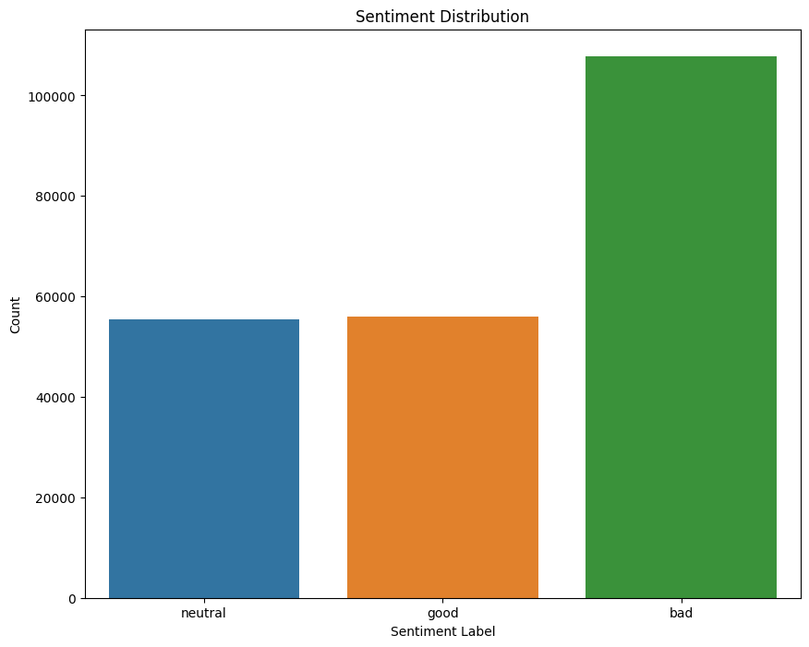
DATA VISUALIZATION
WordWrap
Neutral
Good
Bad
BarChart

Slide 13



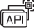







ETL PROCESS
Extract
Transform
Load
Data Extraction
Gather Data from sources
like Kaggle, excel, CSV
Data Transformation
Clean the data and
handle missing values
using python and tensor
flow and visualize the
data in Tableau
Data Storage
Store cleaned and
transformed
data in a database like
PostgreSQL and flask Data
Warehouse

Slide 14

THANK YOU

